Slide 1
Pew Research Center
As Partisan Frustration Grows, Signs of Frustration with the 2-Party System (2022)
The Partisan Divide on Political Values Grows Even Wider (2017)
Partisanship and Political Animosity in 2016 (2016)
Political Polarization in the America Public (2014)
Trends in American Values (2012) 1987-2012
Notes:
Source: Pew Research Center, “As Partisan Frustration Grows, Signs of Frustration with the Two-Party System,” published August 9, 2022
Source: Pew Research Center, “The Partisan Divide on Political Values Grows Even Wider: Sharp Shifts Among Democrats on Aid to Needy, Race, and Immigration,” published October 5, 2017
Source: Pew Research Center, “Partisanship and Political Animosity in 2016: Highly Negative Views of the Opposing Party-and its Members,” published on June 22, 2016.
Source: Pew Research Center, “Political Polarization in the American Public, How Increasing Ideological Uniformity and Partisan Antipathy Affect Politics, Compromise and Everyday Life,” June 12 2014.
Source: Pew Research Center, “Partisan Polarization Surges in Bush, Obama Years: Trends in American Values, 1987-2012,” published on June 4, 2012. See http://www.people-press.org/2012/06/04/partisan-polarization-surges-in-bush-obama-years/ . Pew interviewed 3008 respondents between April 4 – 15, 2012.

Slide 2
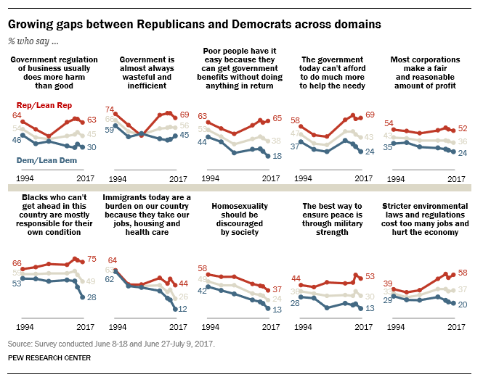
Pew Research Ideological Consistency Scale How to Measure Ideological Consistency
Pew Research asks Republicans, Democrats, and Independents these 10 questions to measure the degree to which one is liberal or conservative
Notes:
Source: Pew Research Center, “The Partisan Divide on Political Values Grows Even Wider: Sharp Shifts Among Democrats on Aid to Needy, Race, and Immigration,” published October 5, 2017
Items in the Ideological Consistency Scale
One who chooses 7 to 10 answers that are associated with being liberal is considered to be consistently liberal. One who chooses 7 to 10 answers that are associated with being conservative is considered to be consistently conservative.
Question # Conservative Position [OR] Liberal Position
Q25a Government is almost always wasteful and inefficient –or– Government often does a better job than people give it credit for
Q25b Government regulation of business usually does more harm than good –or– Government regulation of business is necessary to protect the public interest
Q25c Poor people today have it easy because they can get government benefits without doing anything in return –or– Poor people have hard lives because government benefits don't go far enough to help them live decently
Q25d The government today can't afford to do much more to help the needy –or– The government should do more to help needy Americans, even if it means going deeper into debt Q25f Blacks who can't get ahead in this country are mostly responsible for their own condition –or– Racial discrimination is the main reason why many black people can't get ahead these days
Q25g Immigrants today are a burden on our country because they take our jobs, housing and health care –or– Immigrants today strengthen our country because of their hard work and talents
Q25i The best way to ensure peace is through military strength –or– Good diplomacy is the best way to ensure peace
Q25n Most corporations make a fair and reasonable amount of profit –or– Business corporations make too much profit
Q50r Stricter environmental laws and regulations cost too many jobs and hurt the economy –or– Stricter environmental laws and regulations are worth the cost
Q50u Homosexuality should be discouraged by society –or– Homosexuality should be accepted by society

Slide 3
Partisan Polarization
2014 - 2022
Notes:
A “partisan” is a loyal member of one party. The more “partisan” one is, the more loyal that person is to his or her party.
“Partisanship” refers to loyalty to a political party; it reflects beliefs and feelings favorable to one party and less favorable to the other party.
“Polarization” refers to differences between members of each political party. Greater polarization means that the differences are more intense between the two sides.
Ideology is a (strong) belief about how government should or should not manage society. Liberals and conservatives have very strong (and different) views on government’s role in society. Moderates have weaker views and typically advocate a position that is a compromise between the views of liberals and conservatives
In general, liberals want more freedom for the individual but more government control of business. A liberal would favor legalization of marijuana and gay marriage, for instance, reasoning that people should be free to choose to experiment with dangerous drugs (provided they do no harm to others in the process) and that gays should have the freedom to form life-long contracts. A liberal would also favor more government control of powerful businesses, such as those that comprise the oil industry, which liberals believe make excessive profits. Generally, liberals want more government spending so that government can provide more services to people. Lastly, liberals tend to want a “good neighbor” policy in foreign affairs, one in which diplomacy and multilateralism is emphasized. Conservatives generally want government to restrict individual freedoms on grounds of morality (and sometimes religious principles) but to allow more freedom for business. A conservative would oppose legalization of marijuana and gay marriage, believing both to be examples of immoral behavior that would be destructive of the common morality which they believe holds our society together. A conservative typically favors less government control of business. For instance, a conservative would want government to lift environmental restrictions so that oil companies can produce more oil here in America to reduce our dependency on foreign oil. Generally, conservatives want less government spending and believe charitable organizations and religious institutions should assume responsibility for most welfare programs the government funds today. Lastly, conservatives advocate a “peace through strength” doctrine in foreign affairs, one in which force or the threat of force is always an option.

Slide 4
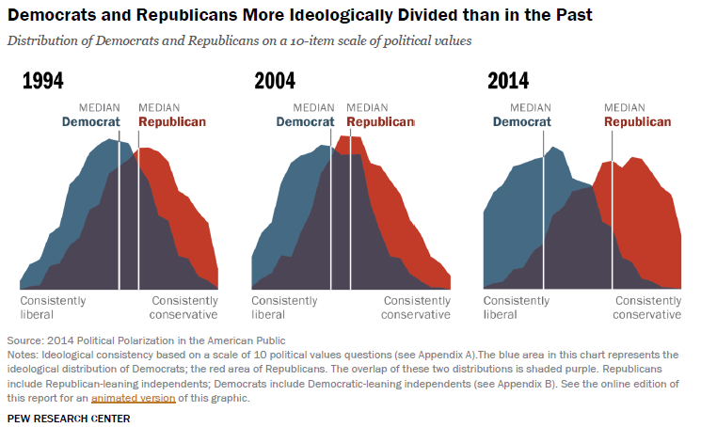
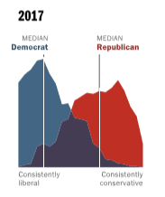
Trends in Partisan Polarization 1994 - 2017
The gap between Republicans and Democrats regarding their respective political opinions and values has widened over time, indicating greater disagreement in 2014 v. 1994
Notes:
Source: Pew Research Center, “Political Polarization in the American Public, How Increasing Ideological Uniformity and Partisan Antipathy Affect Politics, Compromise and Everyday Life,” June 12 2014.
The following three (3) paragraphs are cut and pasted from the Pew Research Center website (2014):
Republicans and Democrats are more divided along ideological lines – and partisan antipathy is deeper and more extensive – than at any point in the last two decades. These trends manifest themselves in myriad ways, both in politics and in everyday life. And a new survey of 10,000 adults nationwide finds that these divisions are greatest among those who are the most engaged and active in the political process.
The overall share of Americans who express consistently conservative or consistently liberal opinions has doubled over the past two decades from 10% to 21%. And ideological thinking is now much more closely aligned with partisanship than in the past. As a result, ideological overlap between the two parties has diminished: Today, 92% of Republicans are to the right of the median Democrat, and 94% of Democrats are to the left of the median Republican.
Partisan animosity has increased substantially over the same period. In each party, the share with a highly negative view of the opposing party has more than doubled since 1994. Most of these intense partisans believe the opposing party’s policies “are so misguided that they threaten the nation’s well-being.”

Slide 5
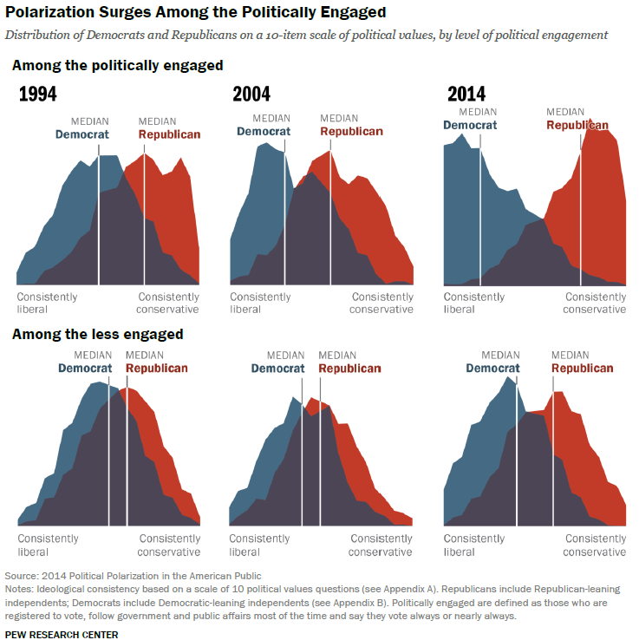
Trends in Partisan Polarization 2014
There is an even larger political-values gap between Republicans and Democrats who are politically engaged, i.e., between those who keep up with politics and government and who vote consistently
Notes:
Source: Pew Research Center, “Political Polarization in the American Public, How Increasing Ideological Uniformity and Partisan Antipathy Affect Politics, Compromise and Everyday Life,” June 12 2014.
The politically engaged are those who are registered to vote, almost always vote, and keep up with politics and government.
Items in the Ideological Consistency Scale
One who chooses 7 to 10 answers that are associated with being liberal is considered to be consistently liberal. One who chooses 7 to 10 answers that are associated with being conservative is considered to be consistently conservative.
Question # Conservative Position [OR] Liberal Position
Q25a Government is almost always wasteful and inefficient –or– Government often does a better job than people give it credit for
Q25b Government regulation of business usually does more harm than good –or– Government regulation of business is necessary to protect the public interest
Q25c Poor people today have it easy because they can get government benefits without doing anything in return –or– Poor people have hard lives because government benefits don't go far enough to help them live decently
Q25d The government today can't afford to do much more to help the needy –or– The government should do more to help needy Americans, even if it means going deeper into debt Q25f Blacks who can't get ahead in this country are mostly responsible for their own condition –or– Racial discrimination is the main reason why many black people can't get ahead these days
Q25g Immigrants today are a burden on our country because they take our jobs, housing and health care –or– Immigrants today strengthen our country because of their hard work and talents
Q25i The best way to ensure peace is through military strength –or– Good diplomacy is the best way to ensure peace
Q25n Most corporations make a fair and reasonable amount of profit –or– Business corporations make too much profit
Q50r Stricter environmental laws and regulations cost too many jobs and hurt the economy –or– Stricter environmental laws and regulations are worth the cost
Q50u Homosexuality should be discouraged by society –or– Homosexuality should be accepted by society

Slide 6
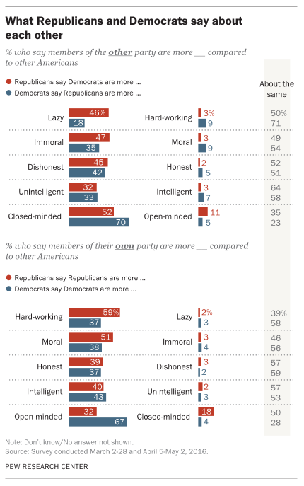
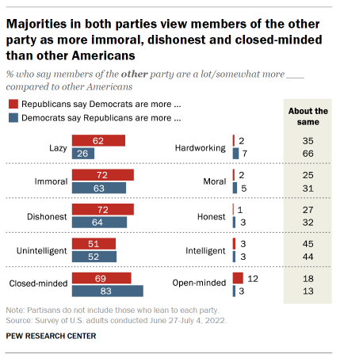
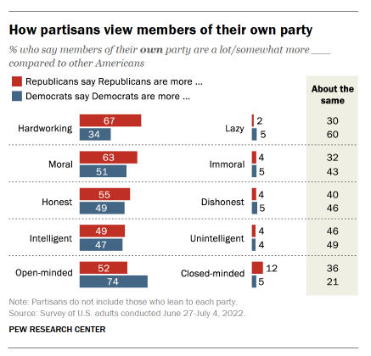
Trends in Partisan Polarization Republicans and Democrats Think the Worst about Each Other
2016
2022
Lazy, immoral, dishonest, unintelligent, and closed-minded are very harsh characterizations that increasing %’s of Republicans and Democrats believe about each other
Republicans view themselves as particularly hard working and moral
Democrats view themselves as particularly open-minded
Notes:
Source: Pew Research Center, “As Partisan Frustration Grows, Signs of Frustration with the Two-Party System,” published August 9, 2022 Source: Pew Research Center, “Partisanship and Political Animosity in 2016: Highly Negative Views of the Opposing Party-and its Members,” published on June 22, 2016.

Slide 7
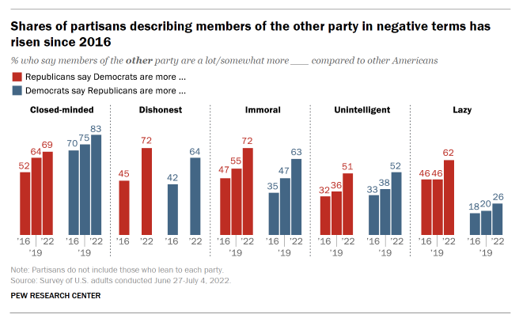
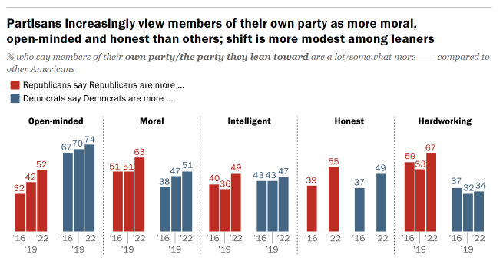
Trends in Partisan Polarization 2016-2022: Increasingly Harsher Views Toward the other Political Party
Increasing %’s with harsher views toward the other party is an indication of high levels of polarization
Small %’s imply that Democrats consider themselves about as hard working as Republicans, but not more hard working
Strong majorities indicate that Democrats believe they are more open-minded than Republicans
Notes:
Source: Pew Research Center, “As Partisan Frustration Grows, Signs of Frustration with the Two-Party System,” published August 9, 2022

Slide 8
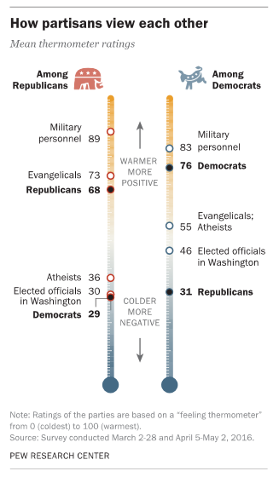
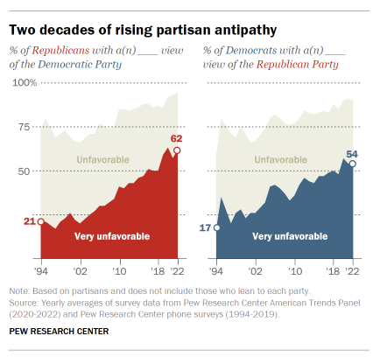
Trends in Partisan Polarization 2016 - 2022
Republicans and Democrats have increasingly unfavorable views of each other
2016
2022
Notes:
Source: Pew Research Center, “As Partisan Frustration Grows, Signs of Frustration with the Two-Party System,” published August 9, 2022
Source: Pew Research Center, “Partisanship and Political Animosity in 2016: Highly Negative Views of the Opposing Party-and its Members,” published on June 22, 2016.

Slide 9
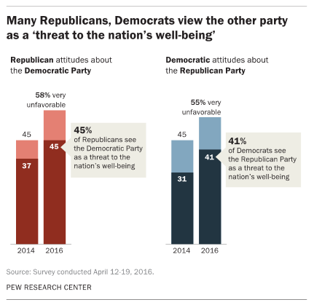
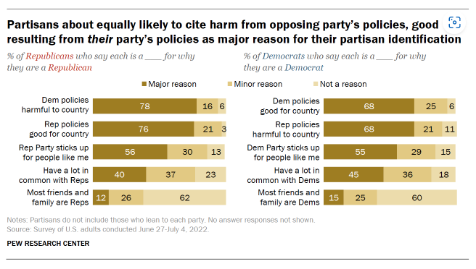
Trends in Partisan Polarization 2016 - 2022
Republicans and Democrats increasingly view the other party’s policies as harmful or even as a threat to our country
2016
2022
Notes:
Source: Pew Research Center, “As Partisan Frustration Grows, Signs of Frustration with the Two-Party System,” published August 9, 2022
Source: Pew Research Center, “Partisanship and Political Animosity in 2016: Highly Negative Views of the Opposing Party-and its Members,” published on June 22, 2016.

Slide 10
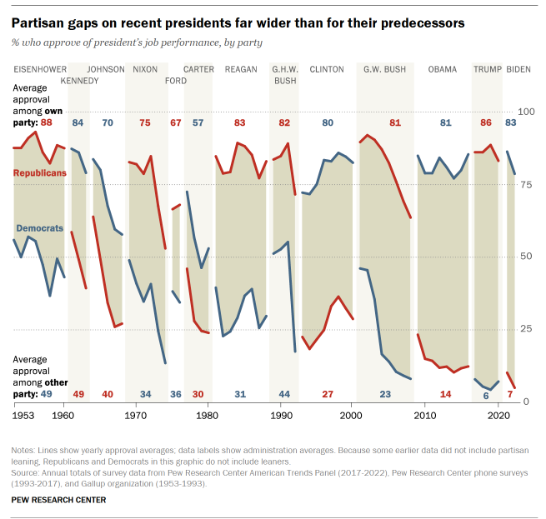
Trends in Partisan Polarization Recent Presidents = More Polarizing
As Republicans and Democrats become more polarized over time, the presidents they elect are viewed as more polarizing
The average partisan gap in approval ratings for Jimmy Carter (1977-1981) was 27%, while the average partisan gap for Donald Trump (2017-2021) was 80%
Notes:
Source: Pew Research Center, “As Partisan Frustration Grows, Signs of Frustration with the Two-Party System,” published August 9, 2022
On average, 57% of Democrats approved of the way Jimmy Carter handled the presidency, while only 30% of Republicans approved. That is a partisan gap of 27% (57 – 30 = 27). Now, let’s fast forward 40 years to Donald Trump. On average, 86% of Republicans approved of the way Donald Trump handled the presidency, while only 6% of Democrats approved. That is a partisan gap of 80% (86 – 6 = 80).

Slide 11
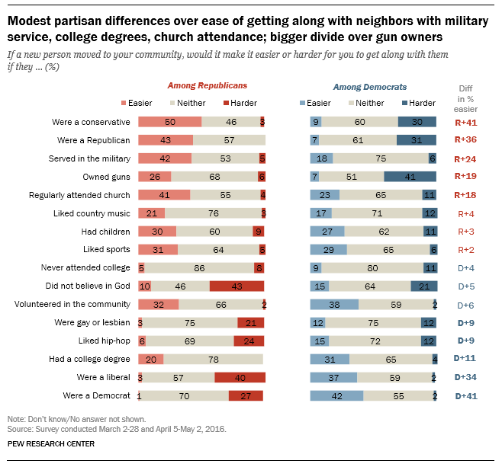
Trends in Partisan Polarization 2016: Cultural Trends
2016: A significant % of Republicans would find it more difficult to get along with a neighbor who is an atheist
A significant % of Democrats would find it difficult to get along with a neighbor who is a gun owner
Notes:
Source: Pew Research Center, “Partisanship and Political Animosity in 2016: Highly Negative Views of the Opposing Party-and its Members,” published on June 22, 2016.

Slide 12
Partisan Polarization
2012

Slide 13
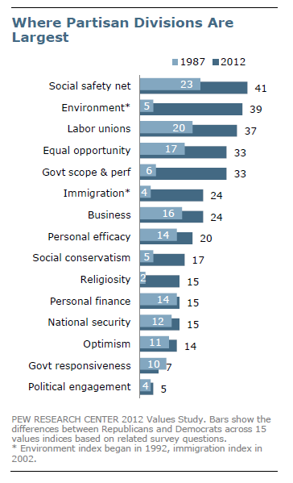
Trends in Partisan Polarization
1987 v. 2012
In 2012, Democrats and Republicans were most intensely divided on issues involving the “social safety net” (e.g., does the government have a responsibility to help those in need?)
Democrats and Republicans were most divided on this issue 25 years ago as well, but the difference has become more intense today
Notes:
Source: Pew Research Center, “Partisan Polarization Surges in Bush, Obama Years: Trends in American Values, 1987-2012,” published on June 4, 2012. See http://www.people-press.org/2012/06/04/partisan-polarization-surges-in-bush-obama-years/ . Pew interviewed 3008 respondents between April 4 – 15, 2012.
How to read the chart: The numbers measure the distance between self-identified Democrats and Republicans. A larger number indicates a greater degree of disagreement between Democrats and Republicans. A smaller number indicates a lesser degree of disagreement (or more agreement) between Democrats and Republicans
There are some differences between this chart and one on the next slide. For instance, self-identified Republicans and Democrats (in 2012) differed most on the “social safety net” (Does government have a responsibility to help those in need?), but Obama and Romney voters (on the next slide) differed most on “government scope and performance” (Is Government generally effective and do you support government regulations?). This indicates that some self-identified Democrats did not vote for Obama, and that some self-identified Republicans did not vote for Romney.

Slide 14
Partisan Polarization
The Consequences

Slide 15
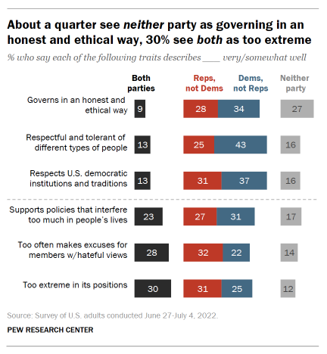
Trends in Partisan Polarization The Consequences: Loss of Trust in the Major Parties
Polarization causes people to lose faith in their government and the political parties that run it
27% believe neither party governs in an honest and ethical way
28% believe that both parties too often make excuses for members with hateful views
30% believe that both parties have too extreme positions
Both parties fair badly in the eyes of the public on respecting U.S. democratic institutions
Notes:
Source: Pew Research Center, “As Partisan Frustration Grows, Signs of Frustration with the Two-Party System,” published August 9, 2022

Slide 16
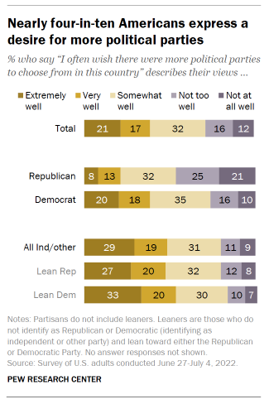
Trends in Partisan Polarization The Consequences: Greater Desire for More Political Parties
Pure Independents and Independents who lean toward a political party tend to want more choices, an alternative to the Republican and Democratic Parties
38% of all polled want more political parties from which to choose
48% of all (pure) Independents want more choices, and 53% of Independents who lean toward the Democratic Party want more choices
Partisan (strong) Republicans tend not to want more choices but rather are satisfied with their Republican Party
Notes:
Source: Pew Research Center, “As Partisan Frustration Grows, Signs of Frustration with the Two-Party System,” published August 9, 2022

